Slide 1
The Lives
of Immigrants

Slide 2
This slideshow includes images, documents, and works of art that tell about what it was like to immigrate to the United States in the early 20th century.

Slide 3
Each slide has an image (or two) and some questions to encourage discussion. These images and documents are important primary source documents that can teach us about life in the past.

Slide 4
Look carefully at the images together. Read the questions, share ideas, and make observations.

Slide 5
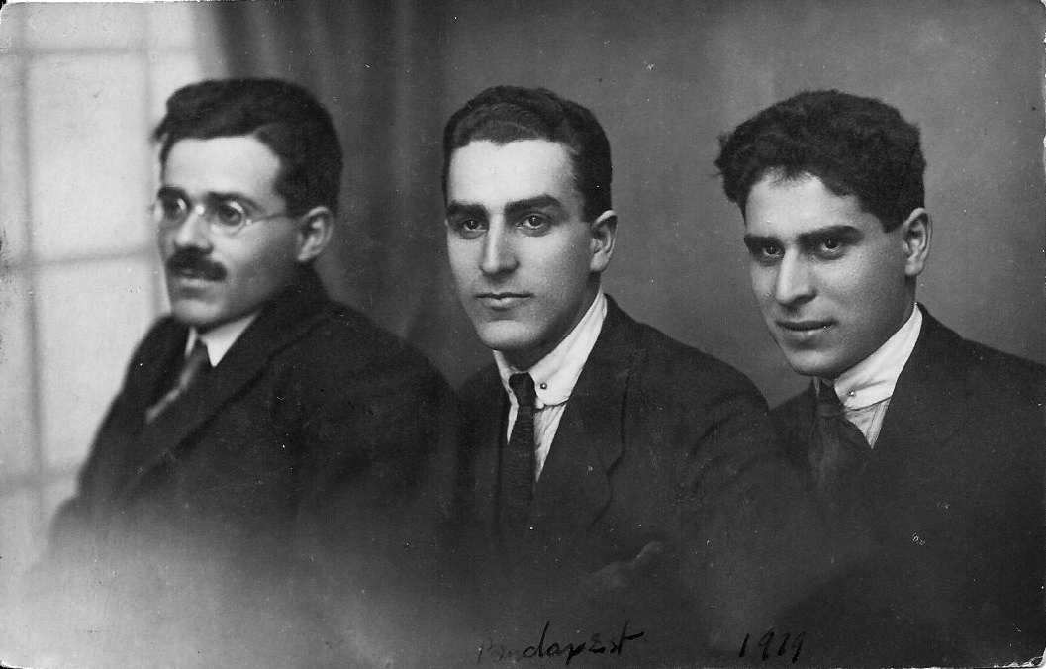
Many people have immigrated to the United States for centuries. To immigrate means to leave your home country to move and settle in a new country. Between 1820-1920, about 34 million immigrants came to this country.
Photograph of Pincus, Abraham, and Chaim Gross, Budapest, 1919, photograph, 3 ⅜ × 5 ¼ inches

Slide 6
Chaim Gross (on the right in this photograph) immigrated from Austria-Hungary (now Ukraine) to New York City with his brother Abraham (middle) in 1921 because of war and violence against Jewish people like them in their home country.
Photograph of Pincus, Abraham, and Chaim Gross, Budapest, 1919, photograph, 3 ⅜ × 5 ¼ inches

Slide 7
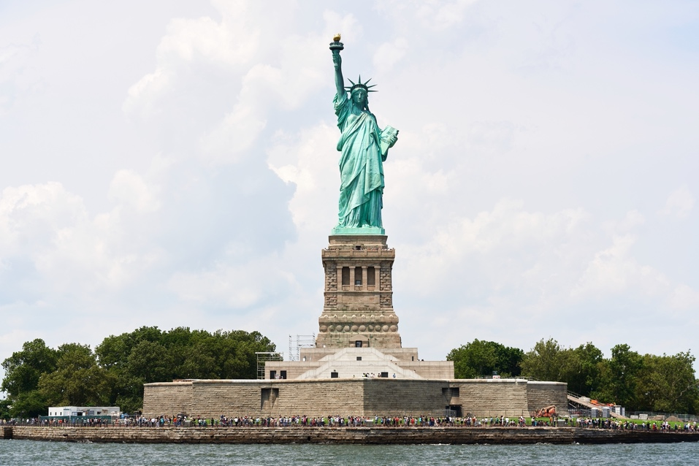
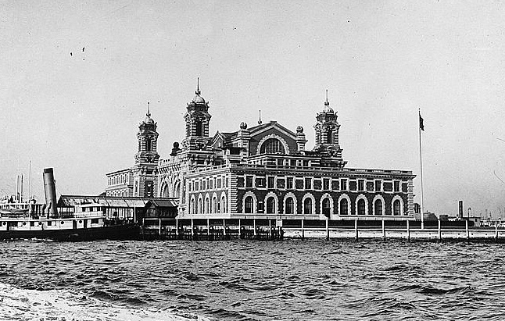
As teenagers, Chaim and his brother Abraham moved to Budapest for a few years, then traveled to France, where they boarded a boat to the United States. One of the first things that immigrants saw when their boat entered New York harbor was the Statue of Liberty (left). They first stopped at Ellis Island to officially enter the United States (right).
Hycaefsiam Hung, Statue of Liberty, 2023, photograph
New York, Ellis Island, 1918–20, glass negative, 4 × 5 inches

Slide 8
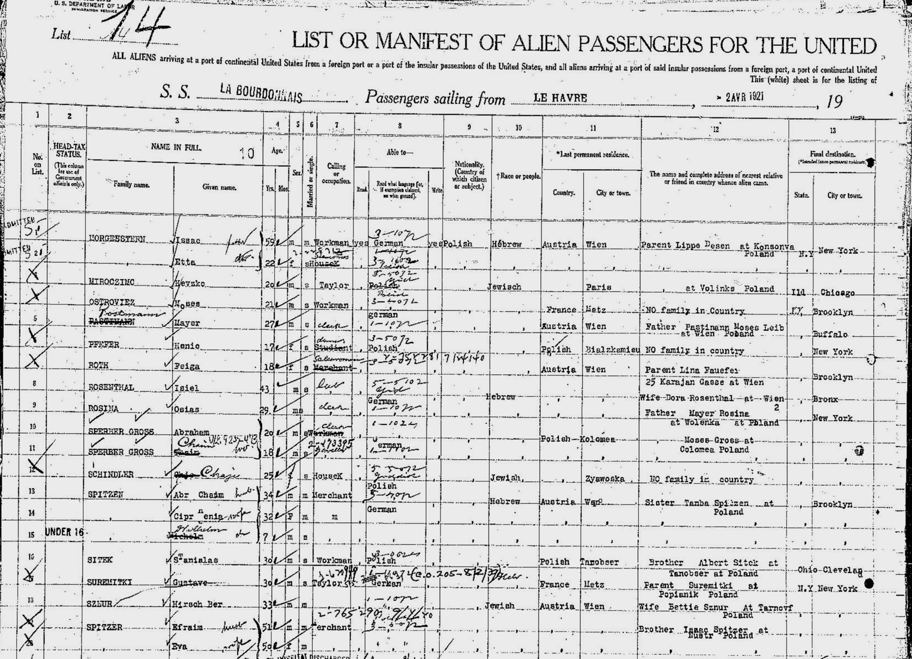
When they arrived at Ellis Island in New York, they were added to a long list of immigrants. Here is an image of that original document. Look for their last name “Sperber Gross”
List or manifest of alien passengers for the United States immigration officer at port of arrival, Frames 161-162, La Bourdonnais, 14 April 1921

Slide 9
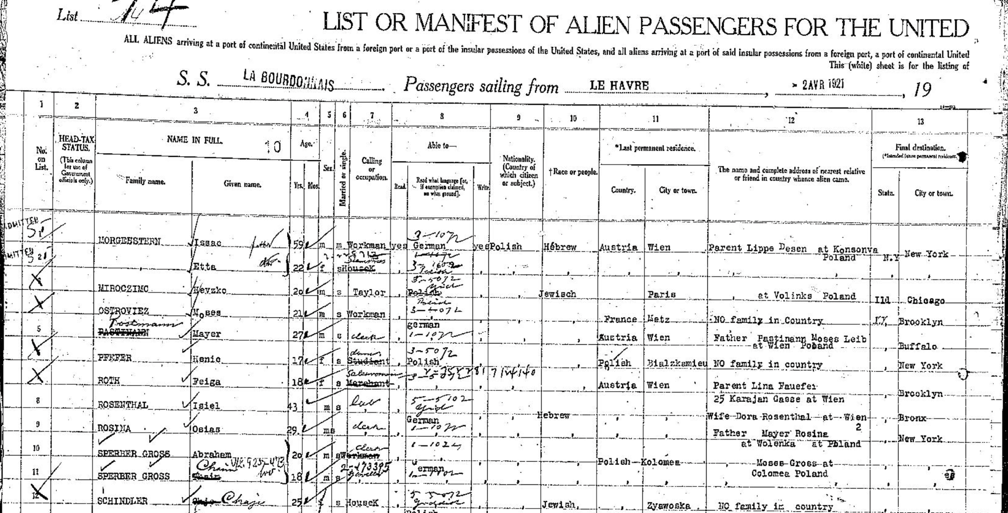
Look closely, and you’ll see that they also recorded the person’s age, nationality, their race, and where they lived before coming to America (circled in red). Why do you think these details were recorded? Why might they be important today?
List or manifest of alien passengers for the United States immigration officer at port of arrival, Frames 161-162, La Bourdonnais, 14 April 1921

Slide 10
In New York City, Chaim studied art and became a sculptor and teacher. The painting on the right shows him and his wife Renee in his studio. It was painted by their friend Moses Soyer, who immigrated to New York with his family in 1912 from Russia.
Moses Soyer, Portrait of Renee and Chaim, 1932, oil on canvas, 27 × 29 inches

Slide 11
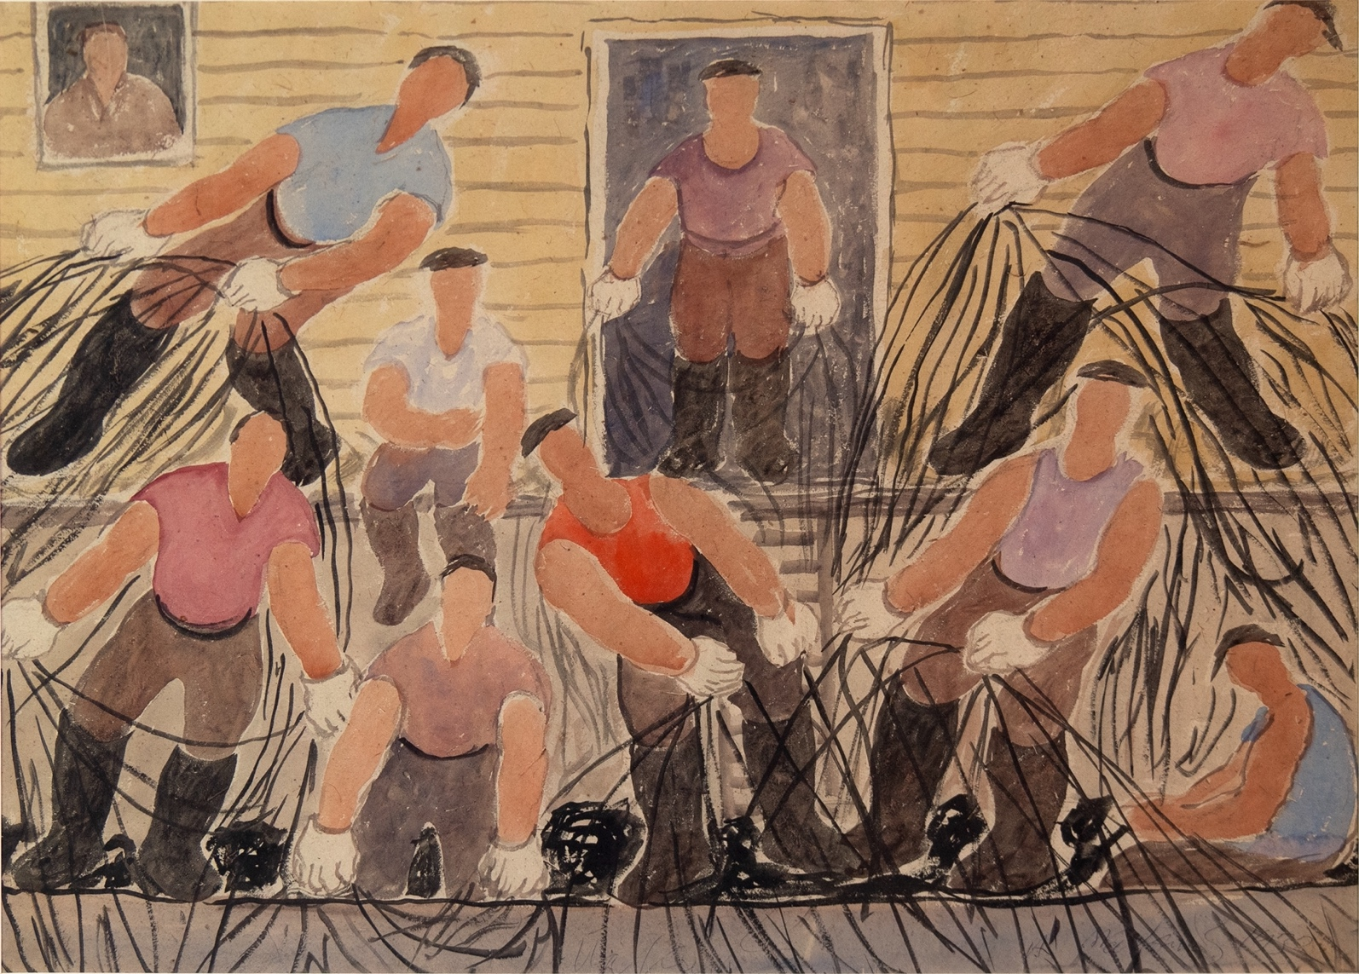
Other immigrants worked as laborers, like the fishermen in the painting on the left by Abraham Walkowitz (who immigrated to New York from Russia in 1893). Still others earned money by opening shops, restaurants, and other businesses.
Abraham Walkowitz, Maine Fisherman, 1932, watercolor and black crayon on paper, 21 × 29 inches

Slide 12
Take a quiet moment to look at each artwork. What is going on in each painting? What are the people doing and how do you think they are feeling? What do you see that tells you that? What do you think would be hard about finding work in a new country?
Moses Soyer, Portrait of Renee and Chaim, 1932, oil on canvas, 27 × 29 inches
Abraham Walkowitz, Maine Fisherman, 1932, watercolor and black crayon on paper, 21 × 29 inches

Slide 13
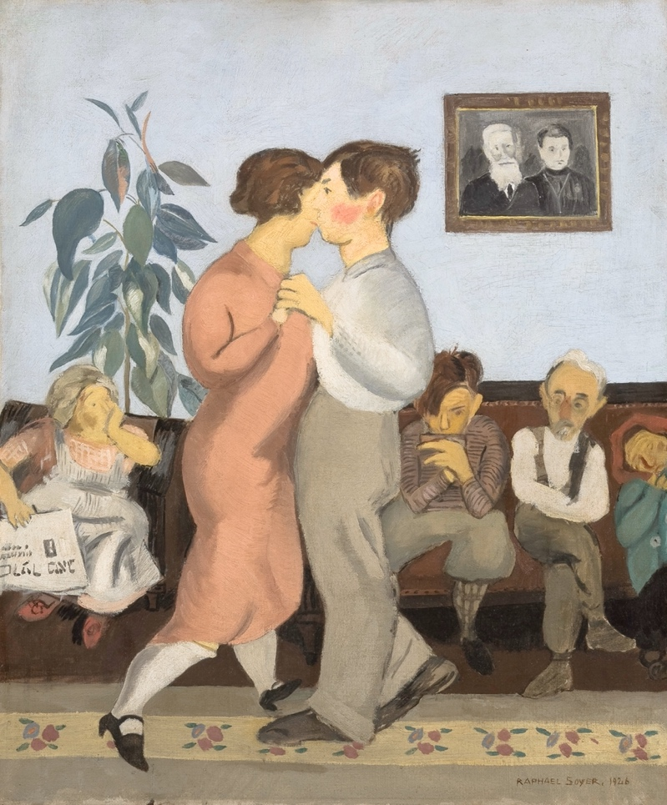
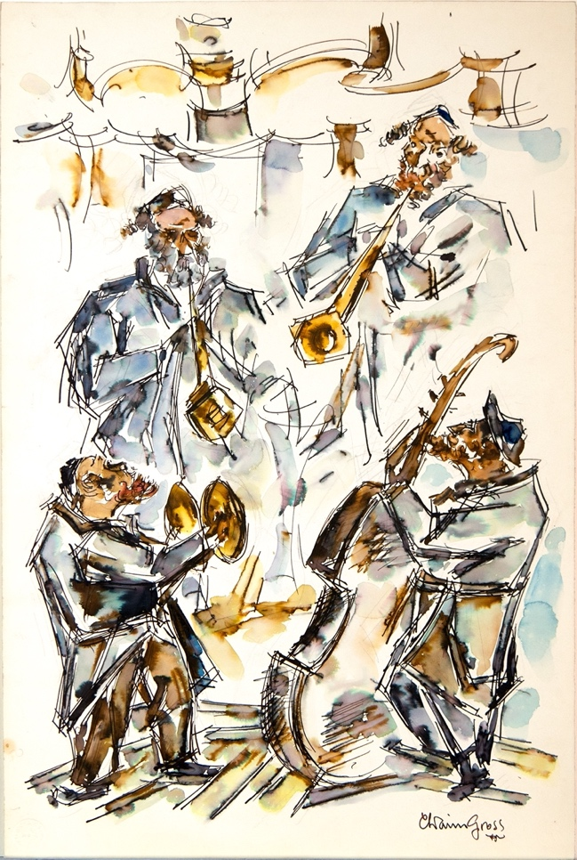
Immigrants brought cultural traditions from their home countries to the United States. Here is an image of a dancing lesson (left) and a musical performance (right) that were made in the 1920s (check date of Chaim’s drawing).
Raphael Soyer, Dancing Lesson, 1926, oil on canvas, 24 ¹⁄₁₆ × 20 ⅛ inches
Chaim Gross, Klezmer, c. 1960, watercolor and pen on paper, 22 ¾ × 15 ⅜ inches

Slide 14
What details do you notice in the images? Describe the people that you see and what they are doing. What do you wonder? What stories do you think the images tell us?
Raphael Soyer, Dancing Lesson, 1926, oil on canvas, 24 ¹⁄₁₆ × 20 ⅛ inches
Chaim Gross, Klezmer, no date, watercolor and pen on paper, 22 ¾ × 15 ⅜ inches

Slide 15
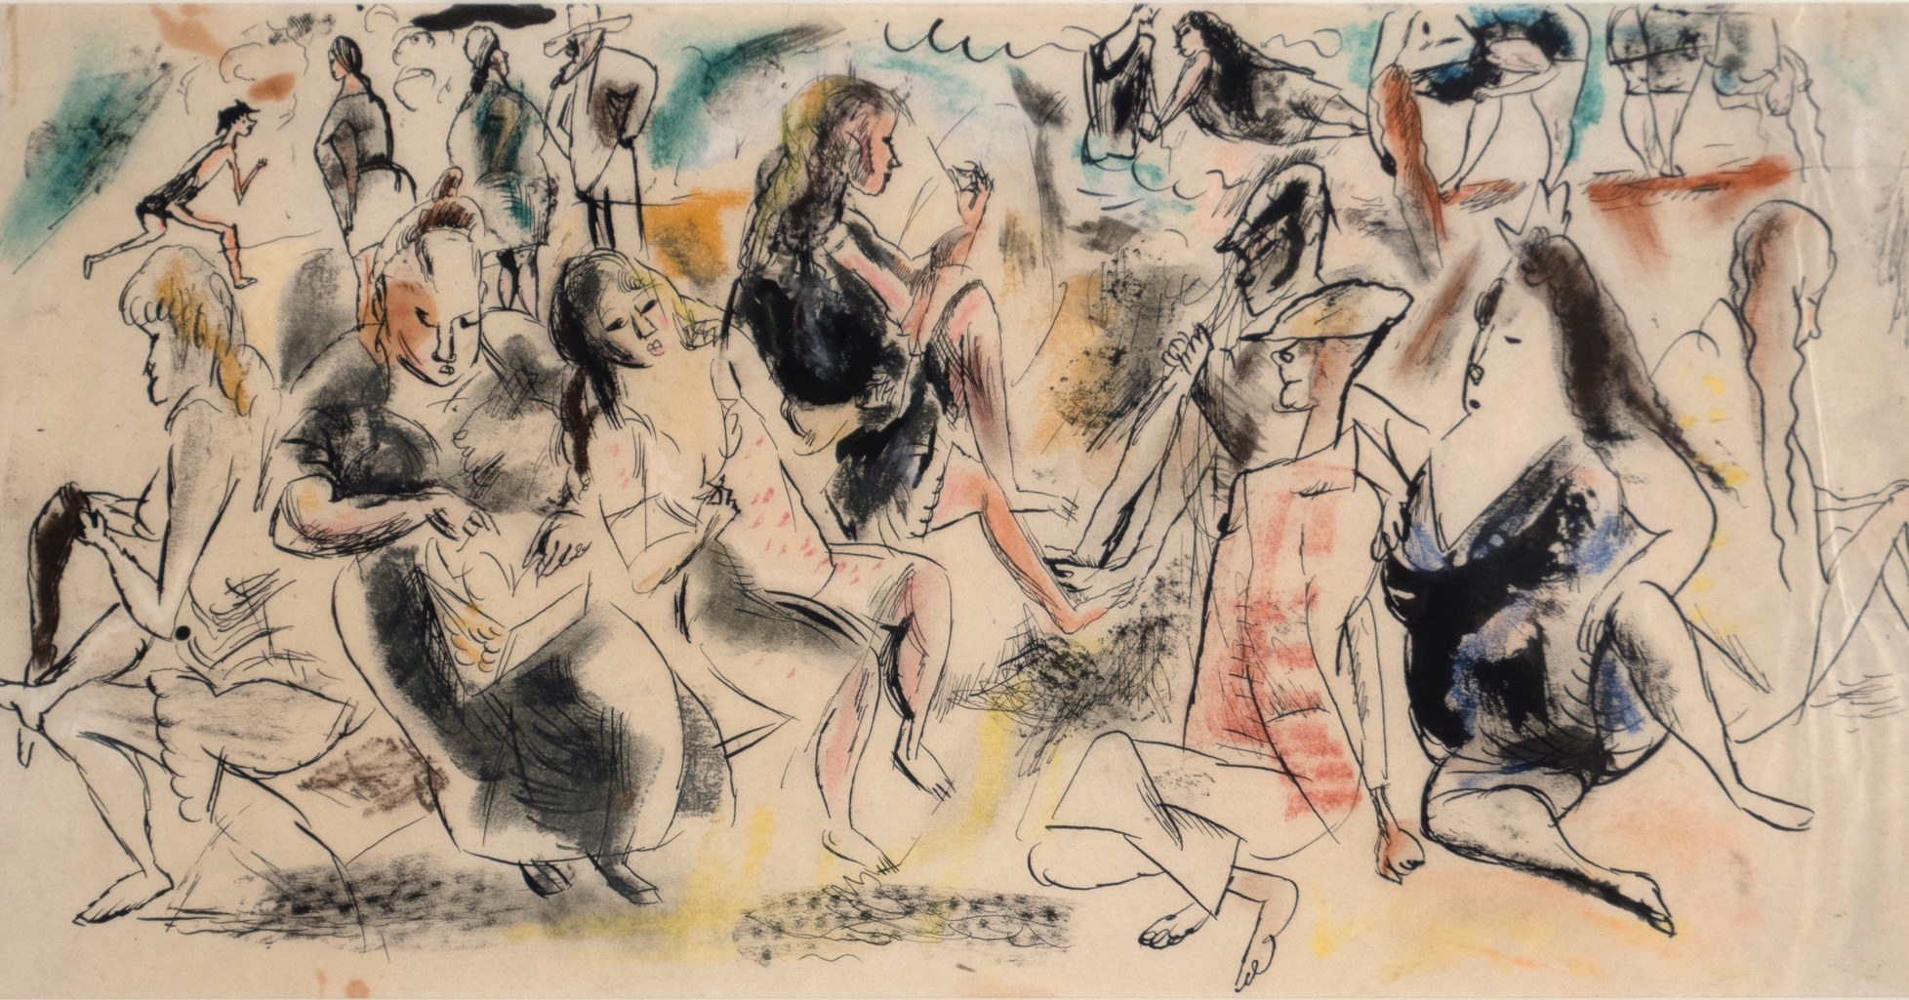
New immigrants faced many challenges and worked hard to establish a new life in America. Finding time to enjoy some fun was also important. Jules Pascin, who immigrated to the US in 1914 to escape WWI, painted the image you see here.
Jules Pascin, Coney Island, c. 1917, ink, watercolor, and crayon on paper, 6 ¼ × 12 ½ inches

Slide 16
This work of art shows a crowded beach scene at Coney Island. What’s going on in this picture? What do you think it would feel like to be there? If you have visited a beach, how does it compare to your experience?
Jules Pascin, Coney Island, c. 1917, ink, watercolor, and crayon on paper, 6 ¼ × 12 ½ inches

Slide 17
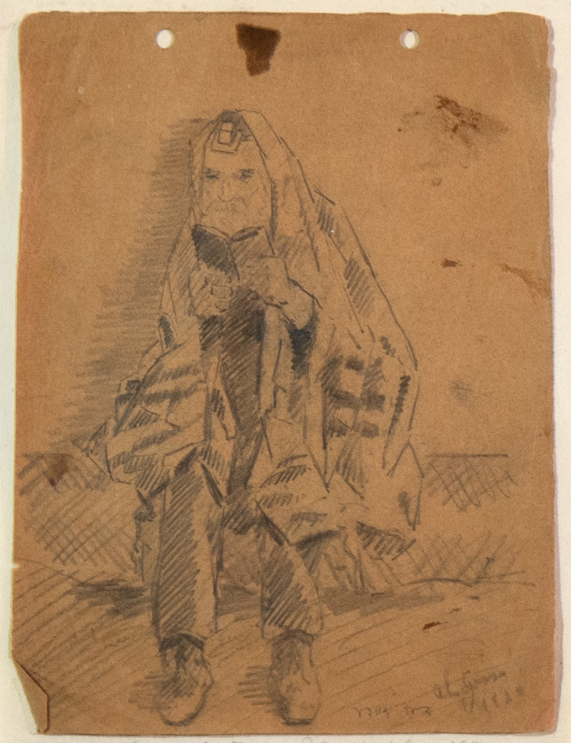
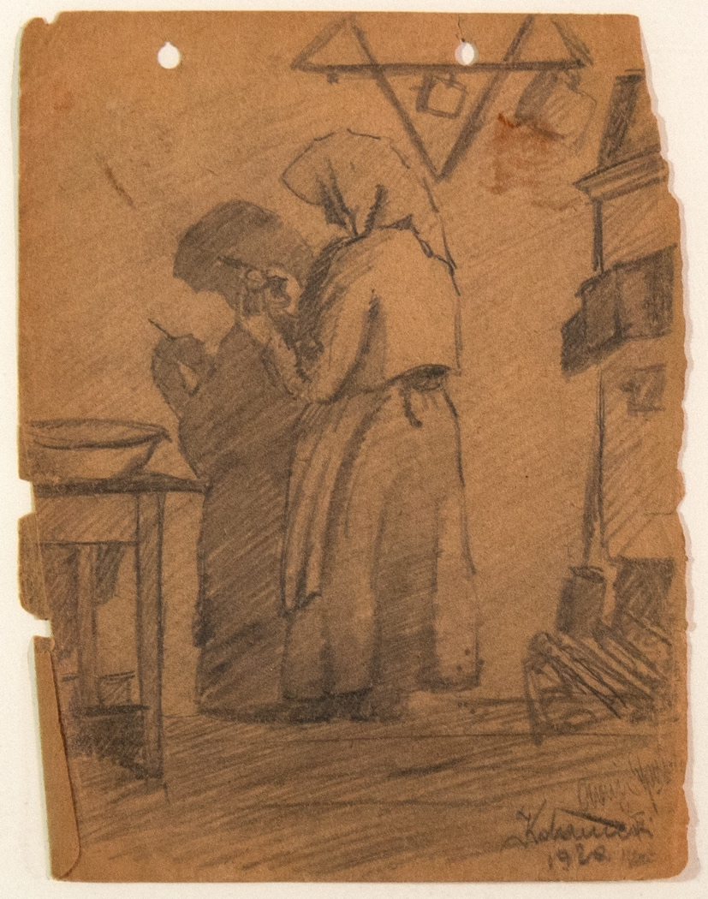
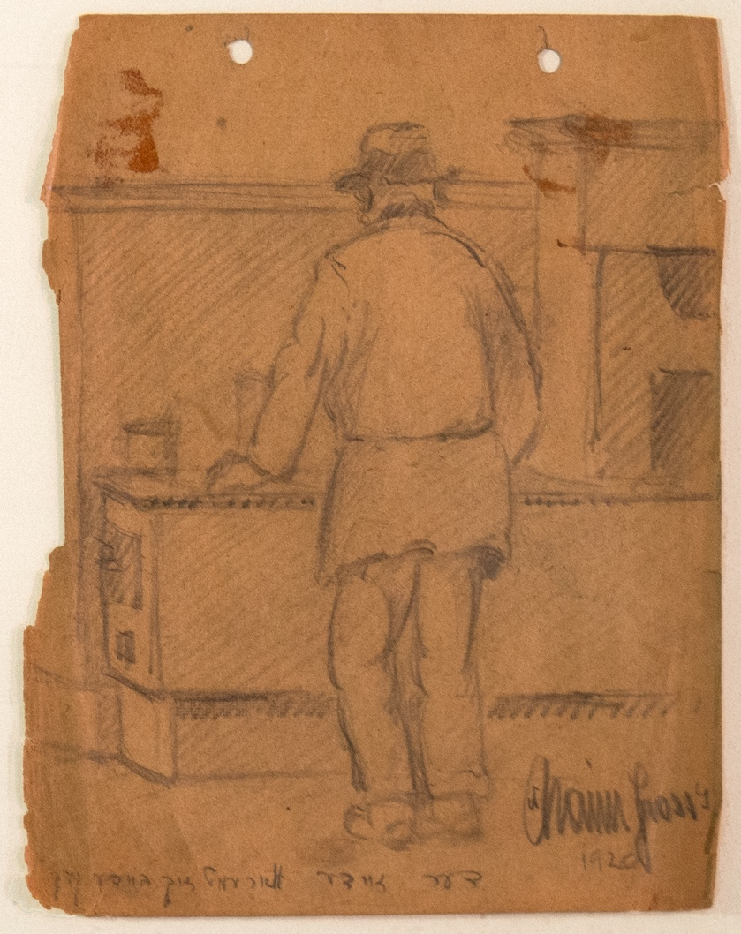
One of the items Chaim brought with him to the United States was a sketchbook. Here are a few of the drawings inside. These drawings show Chaim’s parents and grandfather, back in Europe.
Chaim Gross, Drawings of My Grandfather, Mother, and Father, 1920, graphite on paper, 8 × 6 inches, 8 × 6 1/8 inches, 8 × 6 1/8 inches

Slide 18
Look closely at the drawings for a few moments. What do you notice about each drawing? Why do you think he brought these drawings with him? What would you bring with you if you were immigrating to a new country?
Chaim Gross, Drawings of My Grandfather, Mother, and Father, 1920, graphite on paper, 8 × 6 inches, 8 × 6 1/8 inches, 8 × 6 1/8 inches

Slide 19
Image Credits
Photograph of Pincus, Abraham, and Chaim Gross, Budapest, 1919, photograph, 3 ⅜ × 5 ¼ inches. Archives of the Renee & Chaim Gross Foundation, New York.
Hycaefsiam Hung, Statue of Liberty, 2023, photograph. From Wikimedia Commons.
New York, Ellis Island, 1918–20, glass negative, 4 × 5 inches. Library of Congress Prints and Photographs Division, LC-DIG-npcc-00224.
List or manifest of alien passengers for the United States immigration officer at port of arrival, Frames 161-162, La Bourdonnais, 14 April 1921. Courtesy of Liberty–Ellis Island Foundation, Inc., www.statueofliberty.org.
Moses Soyer, Portrait of Renee and Chaim, 1932, oil on canvas, 27 × 29 inches. Renee & Chaim Gross Foundation, New York. © 2024 Estate of Moses Soyer / Licensed by VAGA at Artists Rights Society (ARS), NY.
Abraham Walkowitz, Maine Fisherman, 1932, watercolor and black crayon on paper, 21 × 29 inches. Renee & Chaim Gross Foundation, New York. © artist’s estate.
Raphael Soyer, Dancing Lesson, 1926, oil on canvas, 24 ¹⁄₁₆ × 20 ⅛ inches. The Jewish Museum, New York, gift of the Renee & Chaim Gross Foundation 2008-225. Photo by Richard Goodbody. Reproduced with permission from the Estate of Raphael Soyer.
Chaim Gross, Klezmer, watercolor and pen on paper, 22 ¾ × 15 ⅜ inches. Renee & Chaim Gross Foundation, New York.
Jules Pascin, Coney Island, c. 1917, ink, watercolor, and crayon on paper, 6 ¼ × 12 ½ inches. Renee & Chaim Gross Foundation, New York.
Chaim Gross, Drawings of My Grandfather, Mother, and Father, 1920, graphite on paper, 8 × 6 inches, 8 × 6 ⅛ inches, 8 × 6 ⅛ inches. Private collection.

Slide 20
First established in 1974 with donations from over two dozen close friends and supporters of American artist Chaim Gross (1902-91), the Renee & Chaim Gross Foundation was incorporated as a 501(c)(3) not-for-profit organization in 1989. The Foundation is located in the couple's historic Greenwich Village townhouse and the artist’s studio space at 526 LaGuardia Place.
The Foundation stewards an extensive collection of over 12,000 objects that includes Gross’s sculptures, drawings, and prints; a photographic archive; and their large personal collection of African, Oceanic, Pre-Columbian, American, and European art that remains installed in the townhouse as it was during their lifetimes.
Our mission is to further the legacy of Chaim Gross through high-quality research, exhibitions, and educational activities around our historic building and art collections for audiences in New York City and beyond.
rcgrossfoundation.org
This project is generously supported by a grant from the Dorothy C. Radgowski Learning Through Women’s Achievement in the Arts Grant, a joint effort of Where Women Made History (WWMH), and Historic Artists’ Homes & Studios (HAHS), both programs of the National Trust for Historic Preservation.

