Slide 1
Creative
Expression in Sculpture

Slide 2
This slideshow presents four sculptures that vary in their size, material, and subject matter.

Slide 3
Each slide has an image (or several) and some questions to encourage discussion about the different ways artists create sculptures.

Slide 4
Look carefully at the images together. Read the questions, share ideas, and make observations.

Slide 5
Take a few moments to look carefully at this sculpture. Next, discuss as a group: What do you notice? What does its shape remind you of? What do you think it’s made of? What do you see that makes you say that?
Ruth Vodicka, Untitled Abstract Head, 1955, bronze, 4 × 2 ½ × 2 ½ inches

Slide 6
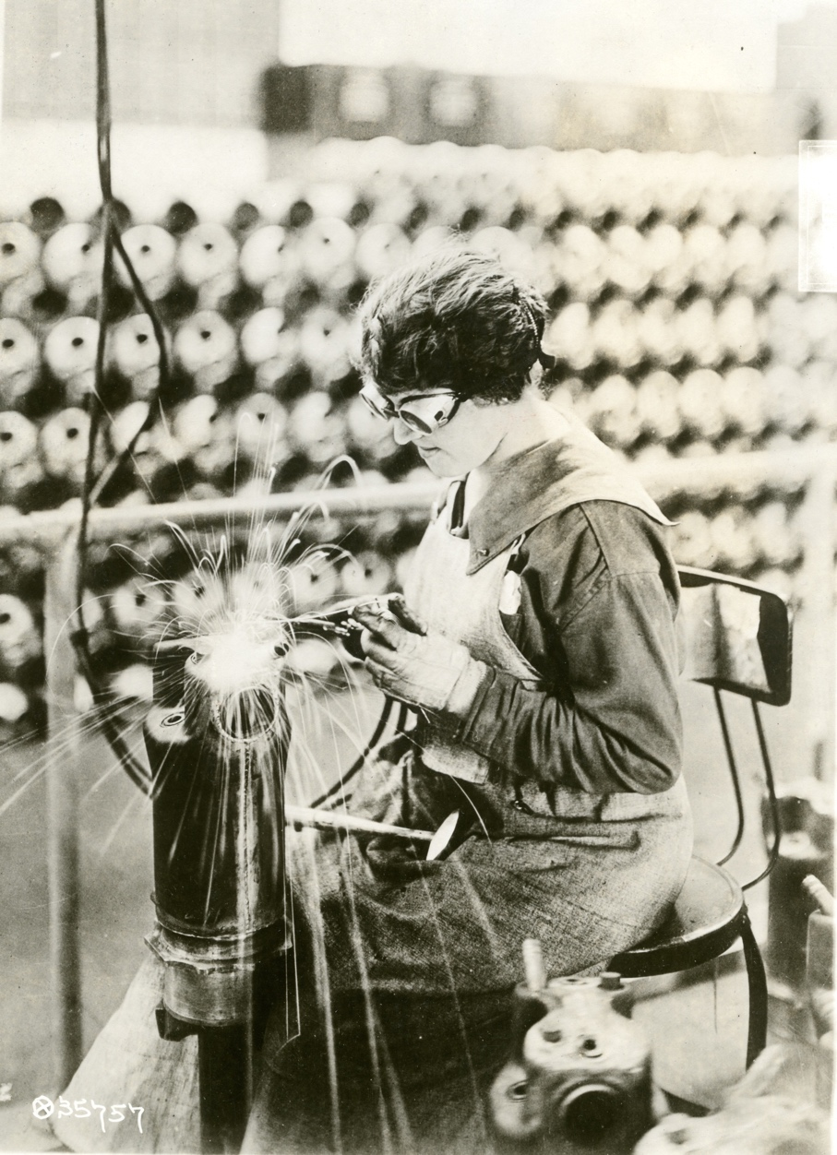
Ruth Vodicka made this sculpture out of bronze. Here is a picture of a woman welding metal. What do you notice about this picture? When welding, the artist is able to join pieces of metal together by heating it to a very high temperature.
A woman welding, 1918, photograph

Slide 7
For this small sculpture (about the size of a fist), Ruth Vodicka was inspired by the shapes in a person’s head. What parts remind you of a head? How did she make it different than an actual head?
Ruth Vodicka, Untitled Abstract Head, 1955, bronze, 4 × 2 ½ × 2 ½ inches

Slide 8
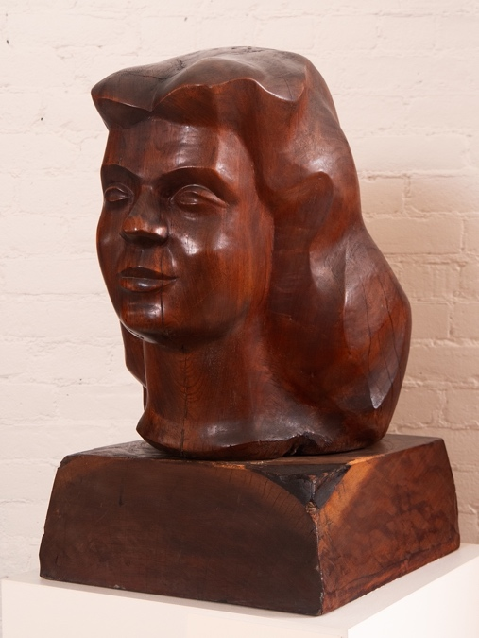
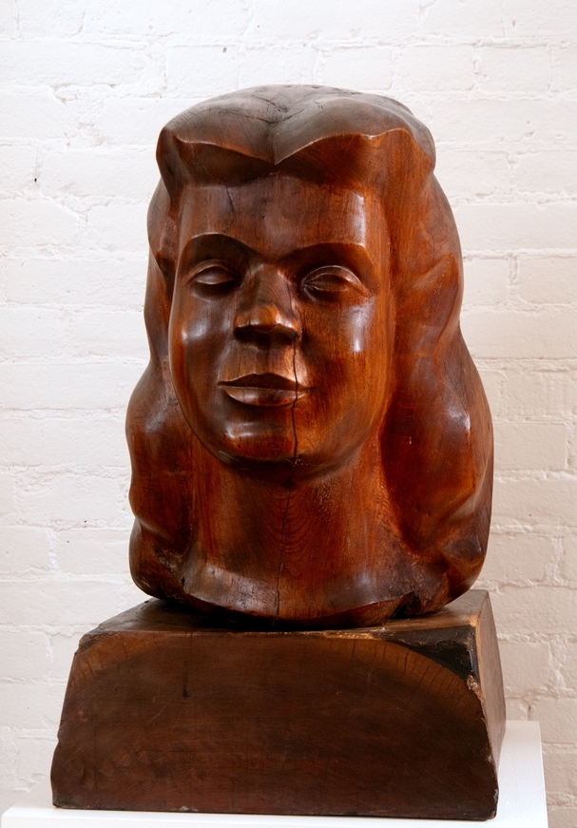
Here is another sculpture of a person’s head. Take a quiet moment to look carefully at it. Then, discuss with the group: What do you notice about this sculpture? What do you think it’s made of, and what do you see that makes you say that? What does the artist tell us about this person? This sculpture, which is a little bigger than life-size, is a portrait that Chaim Gross made of his wife, Renee.
Chaim Gross, Head of Renee, 1938, sabicu wood, 19 ¼ × 14 × 19 inches

Slide 9
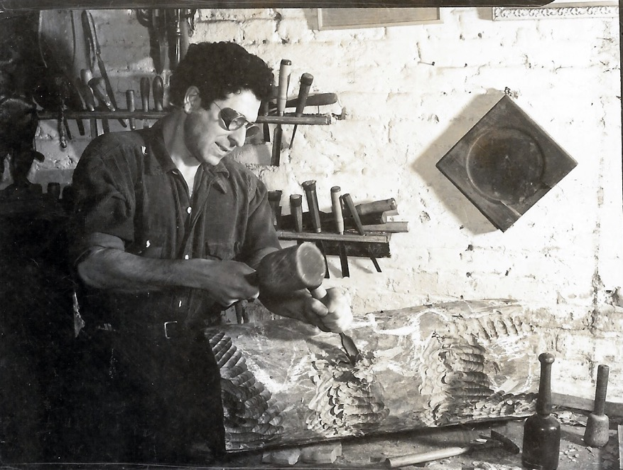
Chaim Gross created his sculpture out of wood. Below, you can see him using a chisel to carve another sculpture out of wood.
Eliot Elisofon, Chaim Gross working on “Acrobats Balancing,” 1938, photograph, 3 ⅛ × 4 ¹⁄₁₆ inches

Slide 10
What are some differences in the tools and materials that each of these artists used? What do you think would be challenging about working with metal and wood?
Eliot Elisofon, Chaim Gross working on “Acrobats Balancing,” 1938, photograph, 3 ⅛ × 4 ¹⁄₁₆ inches
A woman welding, 1918, photograph

Slide 11
What is similar and different about these two sculptures?
Chaim Gross, Head of Renee, 1938, sabicu wood, 19 ¼ × 14 × 19 inches
Ruth Vodicka, Untitled Abstract Head, 1955, bronze, 4 × 2 ½ × 2 ½ inches

Slide 12
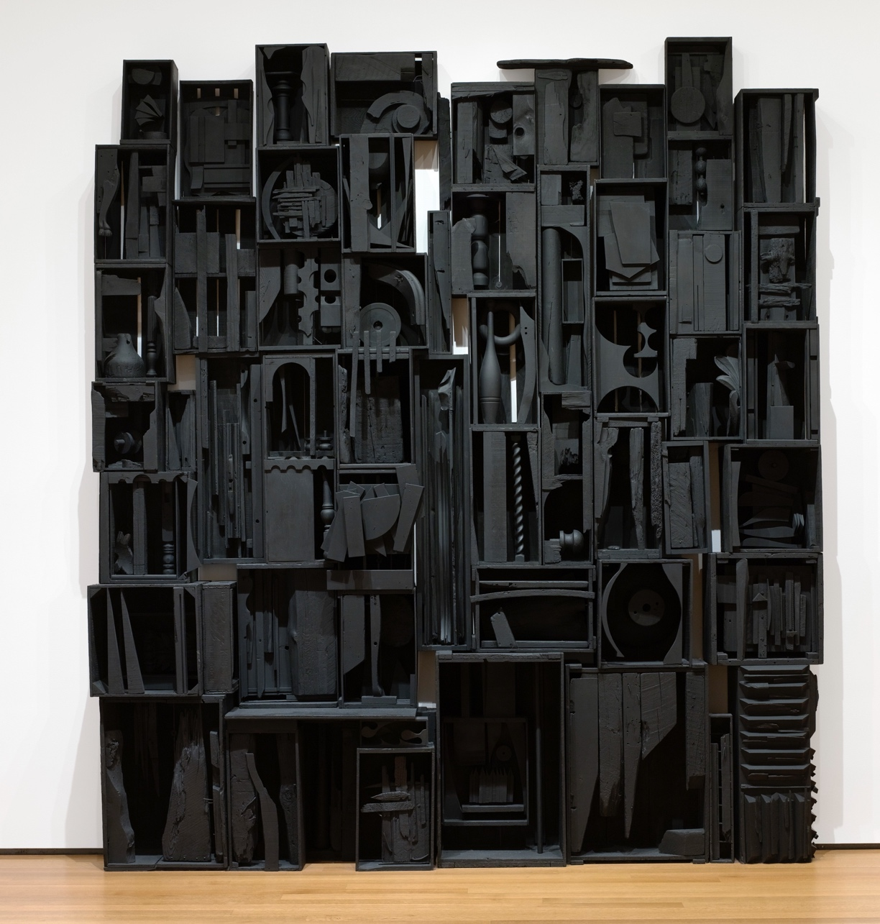
Take a few moments to look carefully at this sculpture. Discuss with the group: What do you notice about some of the different shapes within the sculpture? What do you think it’s made of? What do you see that tells you about that?
Louise Nevelson, Sky Cathedral, 1958, painted wood, 135 ½ × 120 ¼ × 18 inches

Slide 13
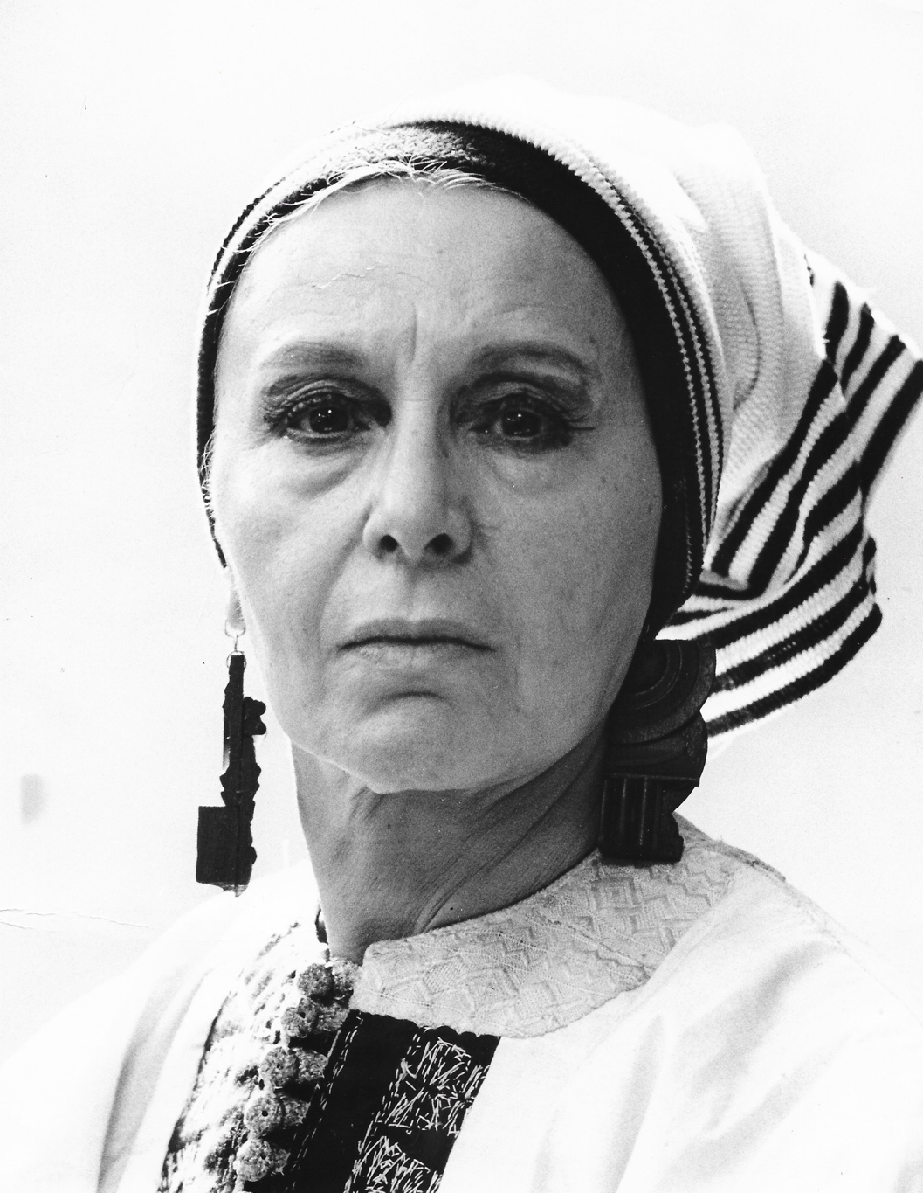
Louise Nevelson, who studied art with Chaim Gross, made this sculpture out of scrap pieces of wood she found, such as chair legs, parts of furniture, and building materials. She assembled them and painted the entire sculpture black. This sculpture is taller than an adult!
Photograph of Louise Nevelson, 1973

Slide 14
What do you notice about how she arranged the pieces of wood? What is similar and different about how Nevelson and Gross worked with wood in their art?
Louise Nevelson, Sky Cathedral, 1958, painted wood, 135 ½ × 120 ¼ × 18 inches

Slide 15
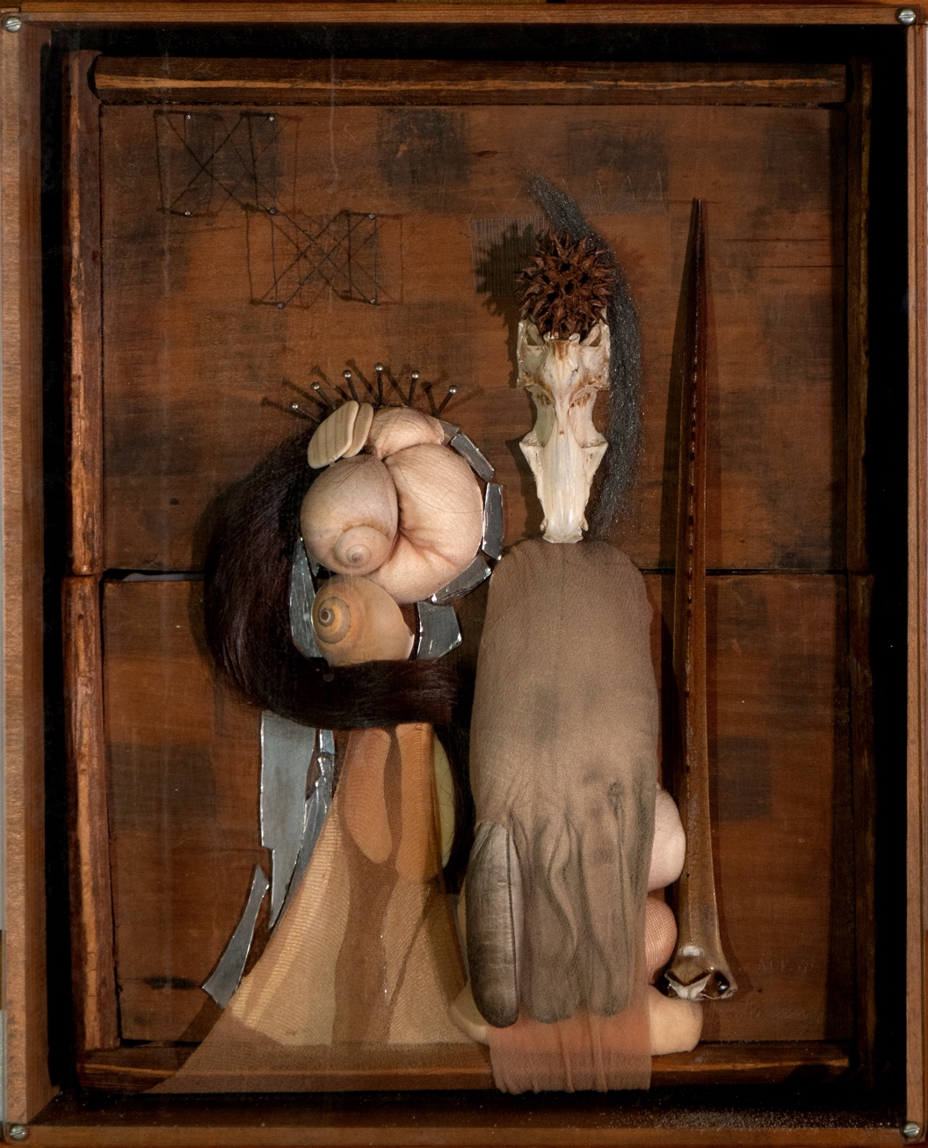
Take a few moments to look carefully at this sculpture. Think about these questions and share your ideas with the group: What do you recognize? What is unfamiliar to you?
Gisela Roessiger, Untitled, 1978, mixed media collage in shadow box, 12 × 10 inches

Slide 16
Gisela Roessiger made this sculpture out of objects she found, including shells, stockings, hair, a glove, a sweetgum ball, and the tail of a horseshoe crab. What do these different objects remind you of? What do they have in common? What story could they tell?
Gisela Roessiger, Untitled, 1978, mixed media collage in shadow box, 12 × 10 inches

Slide 17
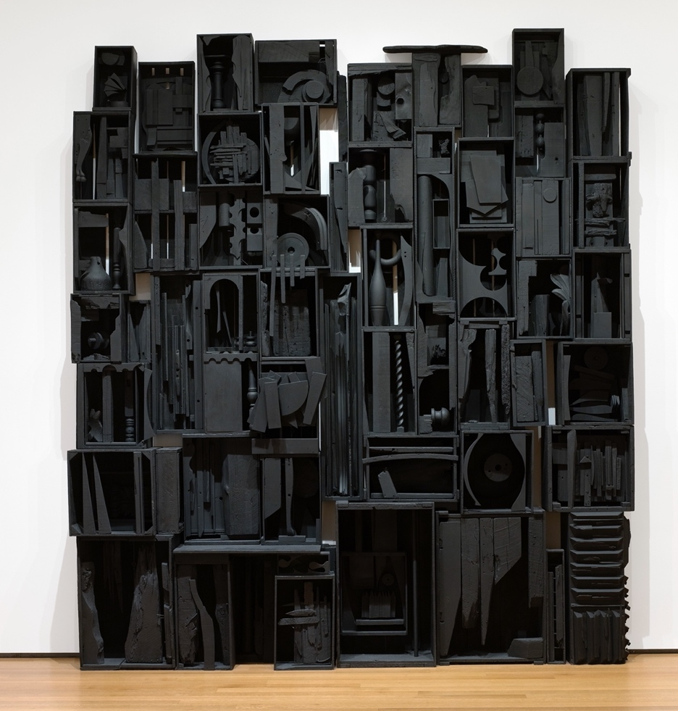
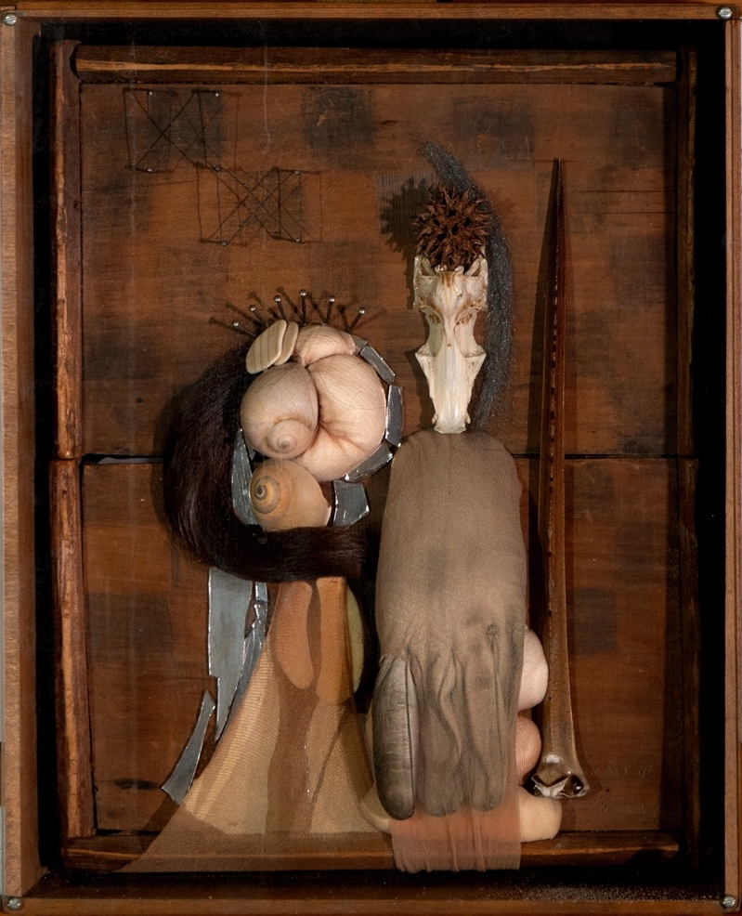
Both of these artists used objects they found to create works of art. What is similar and different about how they created their sculptures?
Louise Nevelson, Sky Cathedral, 1958, painted wood, 135 ½ × 120 ¼ × 18 inches
Gisela Roessiger, Untitled, 1978, mixed media collage in shadow box, 12 × 10 inches

Slide 18
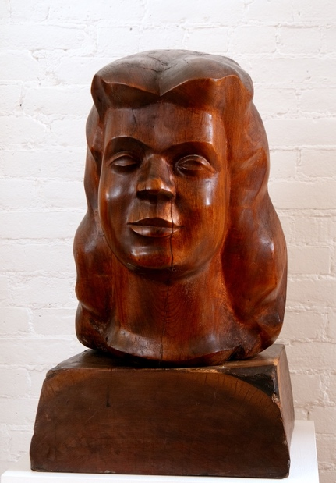
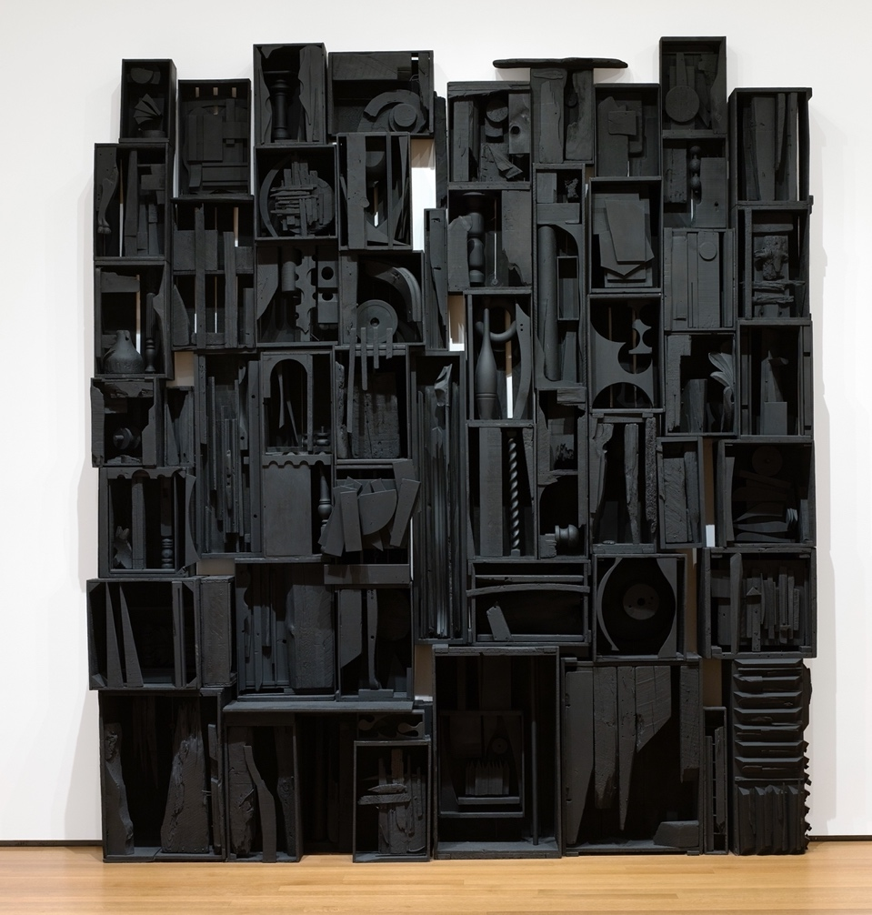
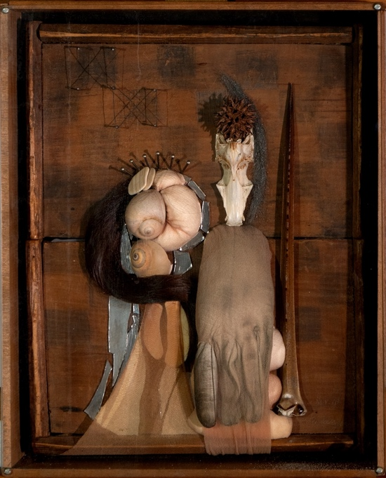
Artists can use different materials, styles, and techniques to create sculptures. There is no wrong way to make art! Every artist is unique and expresses themselves in a different way. How would you like to make art? What ideas would you like to share?

Slide 19
Image Credits
Ruth Vodicka, Untitled Abstract Head, 1955, bronze, 4 × 2 ½ × 2 ½ inches. © artist's estate.
Chaim Gross, Head of Renee, 1938, sabicu wood, 19 ¼ × 14 × 19 inches. Renee & Chaim Gross Foundation, New York.
"Eliot Elisofon, Chaim Gross working on “Acrobats Balancing,” 1938, photograph, 3 ⅛ × 4 ¹⁄₁₆ inches. Archives of the Renee & Chaim Gross Foundation, New York.
A woman welding, 1918, photograph. National Archives and Records Administration.
Louise Nevelson, Sky Cathedral, 1958, painted wood, 135 ½ × 120 ¼ × 18 inches. Digital Image © The Museum of Modern Art/Licensed by SCALA / Art Resource, NY © 2024 Estate of Louise Nevelson / Artists Rights Society (ARS), New York.
Louise Nevelson, 1973, photograph. Photo credit: Pace Gallery. Archives of the Renee & Chaim Gross Foundation, New York.
Gisela Roessiger, Untitled, 1978, mixed media collage in shadow
box, 12 × 10 inches. Renee & Chaim Gross Foundation, New York. © artist or artist's estate.

Slide 20
First established in 1974 with donations from over two dozen close friends and supporters of American artist Chaim Gross (1902-91), the Renee & Chaim Gross Foundation was incorporated as a 501(c)(3) not-for-profit organization in 1989. The Foundation is located in the couple's historic Greenwich Village townhouse and the artist’s studio space at 526 LaGuardia Place.
The Foundation stewards an extensive collection of over 12,000 objects that includes Gross’s sculptures, drawings, and prints; a photographic archive; and their large personal collection of African, Oceanic, Pre-Columbian, American, and European art that remains installed in the townhouse as it was during their lifetimes.
Our mission is to further the legacy of Chaim Gross through high-quality research, exhibitions, and educational activities around our historic building and art collections for audiences in New York City and beyond.
This project is generously supported by a grant from the Dorothy C. Radgowski Learning Through Women’s Achievement in the Arts Grant, a joint effort of Where Women Made History (WWMH), and Historic Artists’ Homes &amp; Studios (HAHS), both programs of the National Trust for Historic Preservation.

