Slide 1
Women Artists:
The Art of Story

Slide 2
This slideshow presents three works of art that describe elements of a story, such as character, setting, and plot.

Slide 3
Each slide has an image and some questions to encourage discussion.

Slide 4
Look carefully at the images together. Read the questions, share ideas, and make observations.

Slide 5
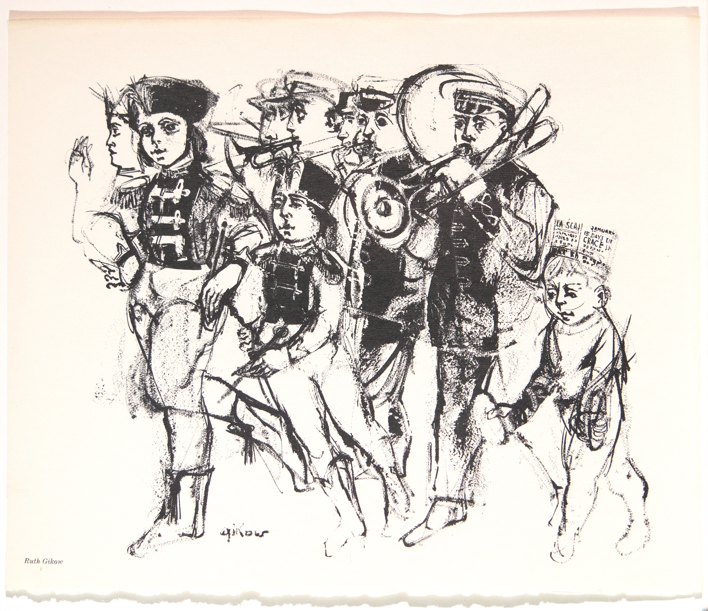
First, take a quiet moment to look at this work of art. Then, discuss these questions as a group: What do you see? What do you think about that? What do you wonder?
Ruth Gikow, Untitled, c. 1959, lithograph, 11 ⅜ × 14 inches

Slide 6
Take turns noticing things and sharing your thoughts. Describe the characters and what makes each one unique. What is everyone doing? What do you see that tells you about their actions?
Ruth Gikow, Untitled, c. 1959, lithograph, 11 ⅜ × 14 inches

Slide 7
Artists often tell stories with their art. What do you think the story is here? Do you think this picture shows the beginning, middle, or end of the story? What do you think happened before, and what might happen next?
Ruth Gikow, Untitled, c. 1959, lithograph, 11 ⅜ × 14 inches

Slide 8
The artist, Ruth Gikow, left some details out of this image. Try and imagine the rest of the picture. What do you think the setting might be? What else might be going on in the background or outside the picture frame?
Ruth Gikow, Untitled, c. 1959, lithograph, 11 ⅜ × 14 inches

Slide 9
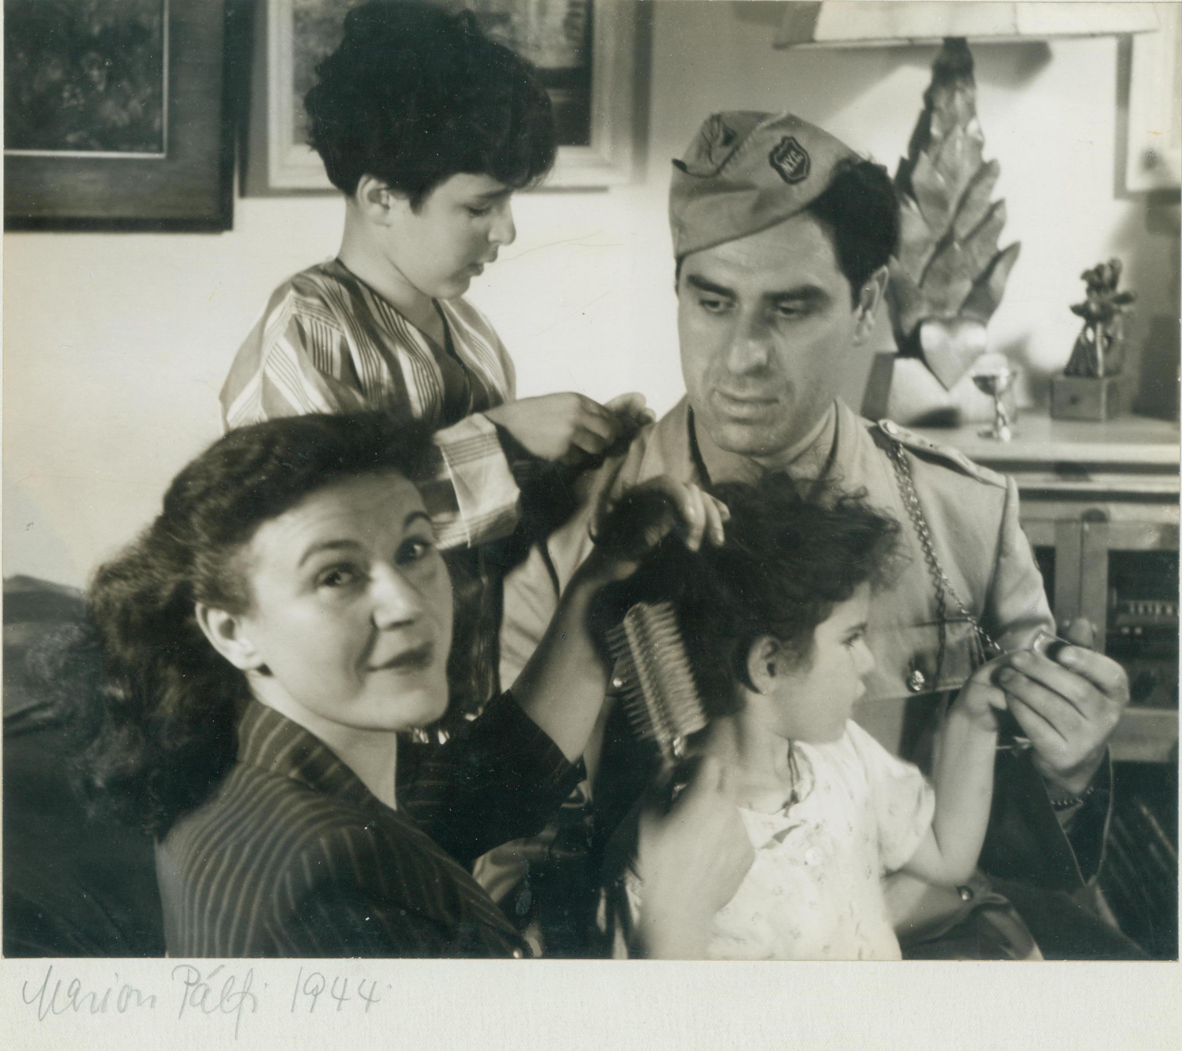
Marion Palfi took this family photograph of Chaim and Renee Gross and their two children, Yehudah and Mimi.
She wanted to capture an everyday moment of the family instead of a posed portrait. Chaim is wearing a uniform for the City Reserve Patrol, a group that helped keep people safe during World War II.
Marion Palfi, Renee and Chaim Gross with their children Mimi and Yehudah, New York City, 1944, photograph, 7 ⅛ × 8 ¾ inches

Slide 10
After looking closely at the picture, discuss:
What is going on in this picture?
What is everyone doing?
Marion Palfi, Renee and Chaim Gross with their children Mimi and Yudie, New York City, 1944, photograph, 7 ⅛ × 8 ¾ inches

Slide 11
What do you notice about the setting? Where might they be?
What can you tell about the family members’ relationship to each other?
What do you see that tells you about that?
What more can you find?
What do you think Marion Palfi wanted
to convey about the Gross family?
Marion Palfi, Renee and Chaim Gross with their children Mimi and Yudie, New York City, 1944, photograph, 7 ⅛ × 8 ¾ inches

Slide 12
If you had a picture taken with some of your friends or family, what would you be doing?
What might you be holding in
your hands?
What would be in the background of the picture?
What would these details tell someone about you?
Marion Palfi, Renee and Chaim Gross with their children Mimi and Yudie, New York City, 1944, photograph, 7 ⅛ × 8 ¾ inches

Slide 13
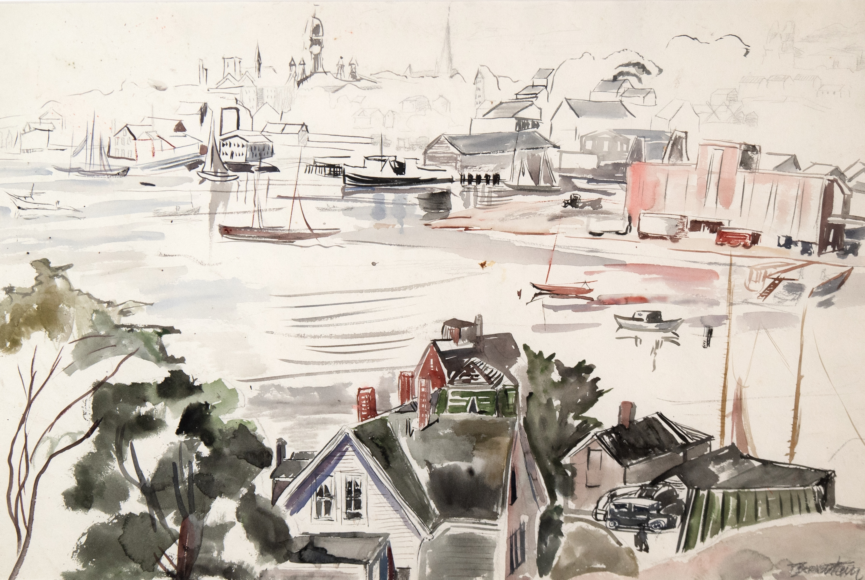
Take a moment to look carefully at this picture.
Then, as a group, describe the setting in this watercolor painted by Theresa Bernstein.
What kinds of buildings do you see?
What else do you notice?
What details can you find in the background?
Have you ever visited a place like this?
Describe your memory of it.
Theresa Bernstein, Rockport, Massachusetts, watercolor on paper, 15 × 22 inches

Slide 14
What do you think it would feel like to walk into this painting and explore?
Imagine this place was the setting for
a story.
Who might the characters be?
What kind of adventure might they have?
Theresa Bernstein, Rockport, Massachusetts, watercolor on paper, 15 × 22 inches

Slide 15
Image Credits
Ruth Gikow, Untitled, c. 1959, lithograph, 11 ⅜ × 14 inches. Renee & Chaim Gross Foundation, New York. © artist's estate.
Marion Palfi, Renee and Chaim Gross with their children Mimi and Yudie, New York City, 1944, photograph, 7 ⅛ × 8 ¾ inches. Archives of the Renee & Chaim Gross Foundation, New York. © Center for Creative Photography, Arizona Board of Regents.
Theresa Bernstein, Rockport, Massachusetts, watercolor on paper, 15 × 22 inches. Renee & Chaim Gross Foundation, New York. © artist's estate.

Slide 16
First established in 1974 with donations from over two dozen close friends and supporters of American artist Chaim Gross (1902-91), the Renee & Chaim Gross Foundation was incorporated as a 501(c)(3) not-for-profit organization in 1989. The Foundation is located in the couple's historic Greenwich Village townhouse and the artist’s studio space at 526 LaGuardia Place.
The Foundation stewards an extensive collection of over 12,000 objects that includes Gross’s sculptures, drawings, and prints; a photographic archive; and their large personal collection of African, Oceanic, Pre-Columbian, American, and European art that remains installed in the townhouse as it was during their lifetimes.
Our mission is to further the legacy of Chaim Gross through high-quality research, exhibitions, and educational activities around our historic building and art collections for audiences in New York City and beyond.
rcgrossfoundation.org
This project is generously supported by a grant from the Dorothy C. Radgowski Learning Through Women’s Achievement in the Arts Grant, a joint effort of Where Women Made History (WWMH), and Historic Artists’ Homes & Studios (HAHS), both programs of the National Trust for Historic Preservation.

