Slide 1
Building Community,
Helping Others

Slide 2
This slideshow is about two important community centers, called settlement houses, that helped people start a new life in New York City after moving there from far away.

Slide 3
Each slide has an image (or two) and some questions to encourage discussion. The historical photographs are important primary source documents that can teach us about life in the past.

Slide 4
Look carefully at the images together. Read the questions, share ideas, and make observations.

Slide 5
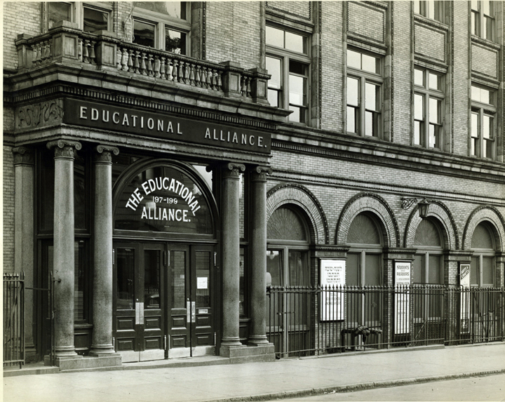
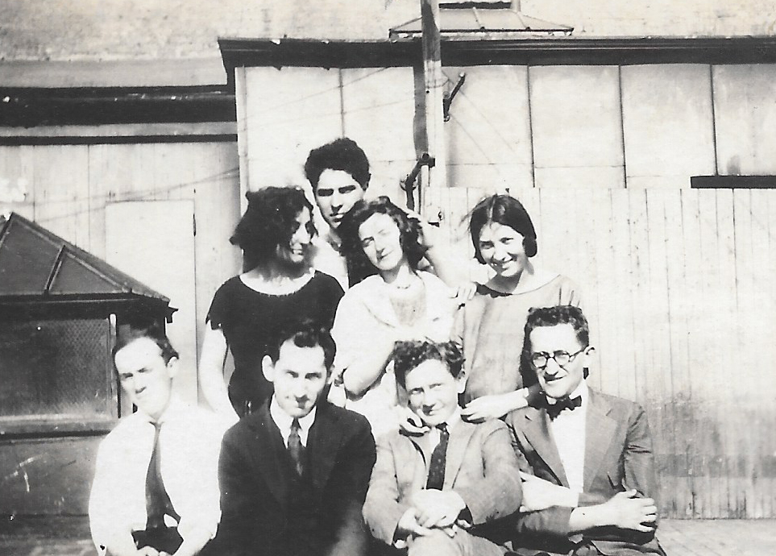
When Chaim Gross first arrived in New York City in 1921, he enrolled in art classes at the Educational Alliance, located in Manhattan’s Lower East Side (pictured below left).
Photograph of the Educational Alliance, c. 1900
Chaim Gross and other students at the Educational Alliance Art School, 1922, photograph, 3 ⅜ × 5 ¼ inches

Slide 6
He met friends, many of whom had also recently immigrated to the United States, studied art, and spoke Yiddish like he did. You can see some of them in the photo on the right. Look closely at these photographs. What do you notice in each?
Photograph of the Educational Alliance, c. 1900
Chaim Gross and other students at the Educational Alliance Art School, 1922, photograph, 3 ⅜ × 5 ¼ inches

Slide 7
Many of the people Chaim met at the Educational Alliance became lifelong friends. What do you think would be important about meeting friends as a new immigrant?
Photograph of the Educational Alliance, c. 1900
Chaim Gross and other students at the Educational Alliance Art School, 1922, photograph, 3 ⅜ × 5 ¼ inches

Slide 8
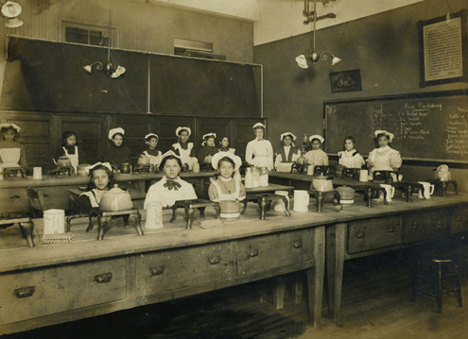
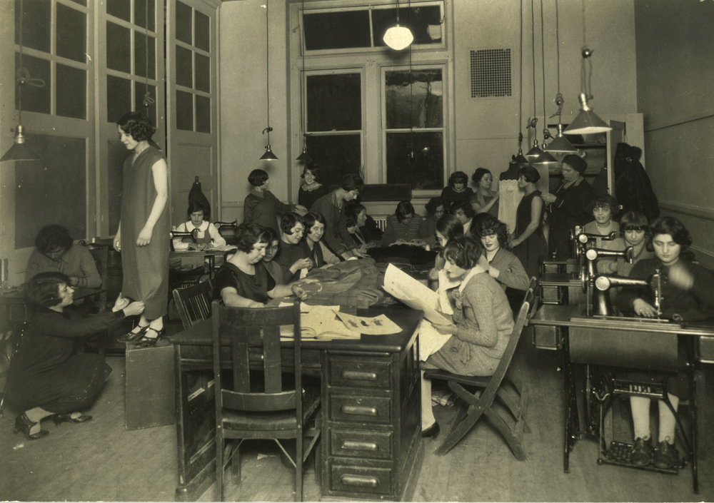
The Educational Alliance helped Jewish immigrants by providing free meals, offering English classes, and teaching skills such as cooking and dress making, as seen in these photos. Take a close look at these images. What are the people doing in each photograph?
Children's cooking class at Educational Alliance, c. 1910, photograph
A class in dressmaking, c. 1920s, photograph

Slide 9
What details do you notice? What do they tell you about this place and the people? Why do you think these skills would be helpful to learn for people who just immigrated to the United States?
Children's cooking class at Educational Alliance, c. 1910, photograph
A class in dressmaking, c. 1920s, photograph

Slide 10
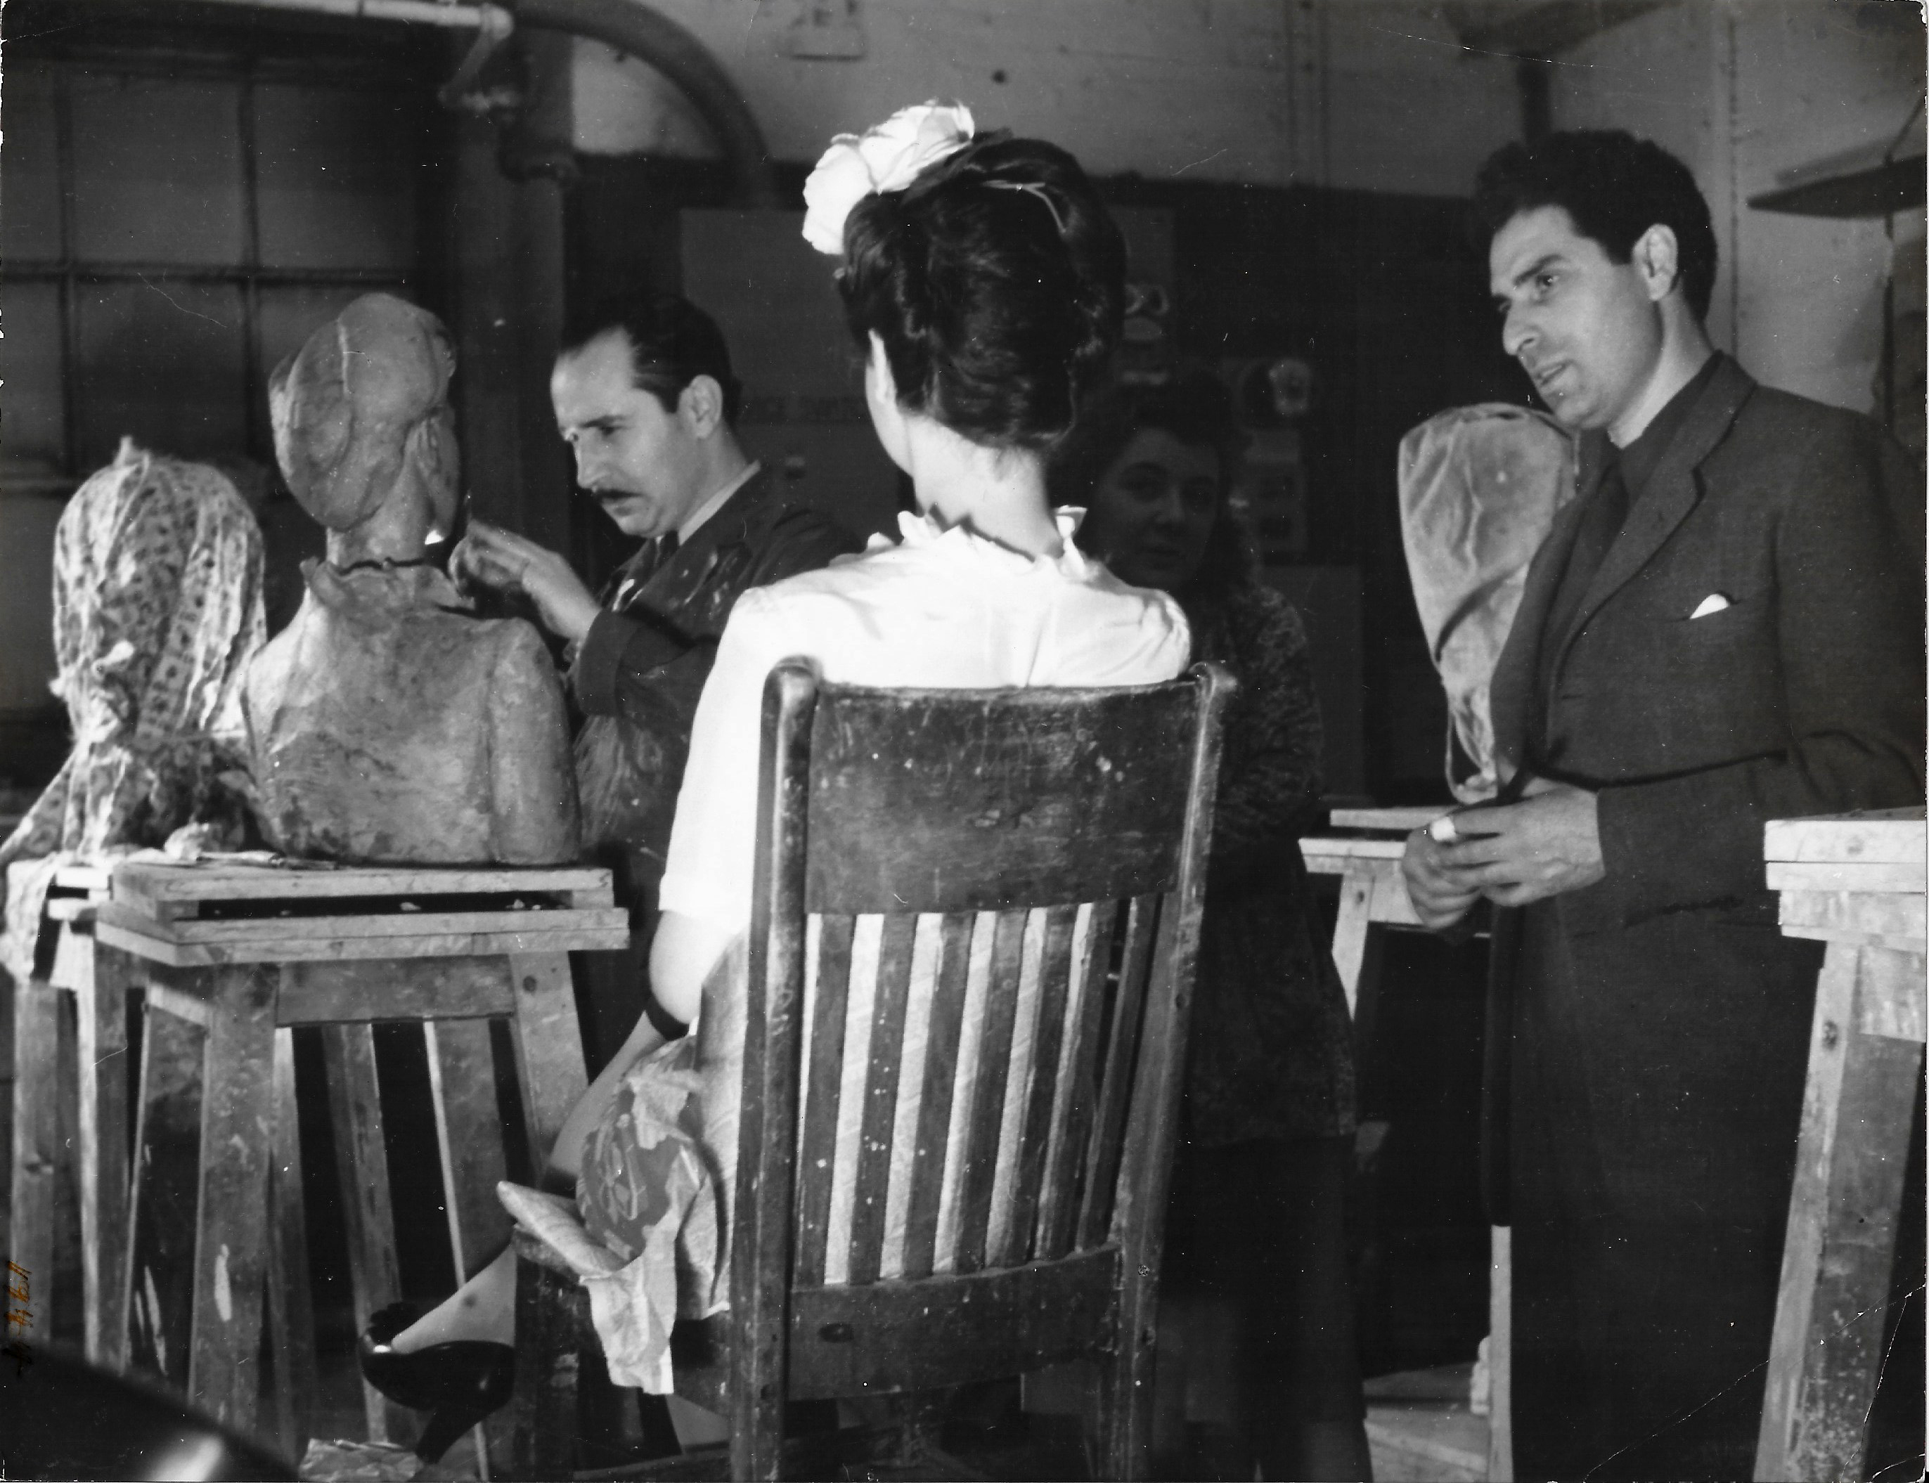
Just six years after arriving in New York, Chaim Gross began teaching art classes at the Educational Alliance. You can see him teaching a sculpture class in this photo (he is on the right side). Look closely at the photograph for a few moments. What is going on in this picture? What do you see that tells you about that?
Marion Palfi, Chaim Gross teaching at the Educational Alliance, 1944, photograph, 7 × 9 ⅛ inches

Slide 11
Chaim Gross taught at the Alliance for over fifty years. He remained grateful to them for helping him as a young artist, and he loved giving back by continuing to teach.
Marion Palfi, Chaim Gross teaching at the Educational Alliance, 1944, photograph, 7 × 9 ⅛ inches

Slide 12
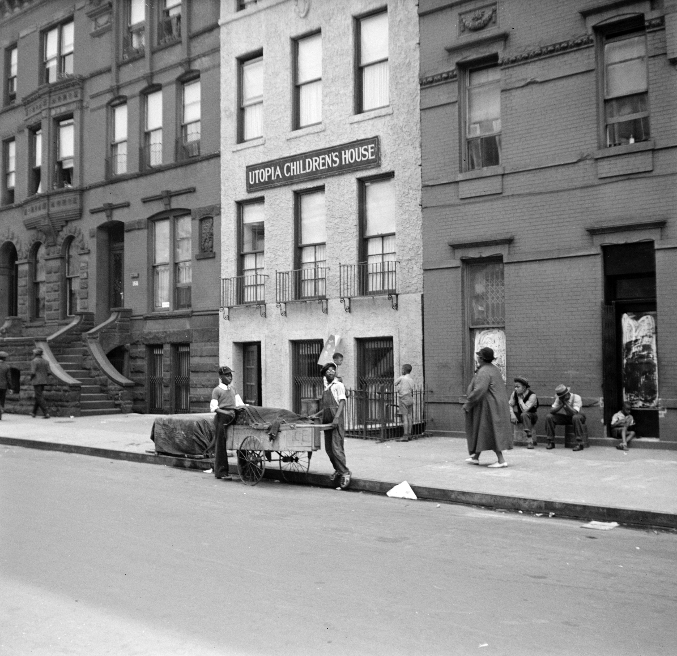
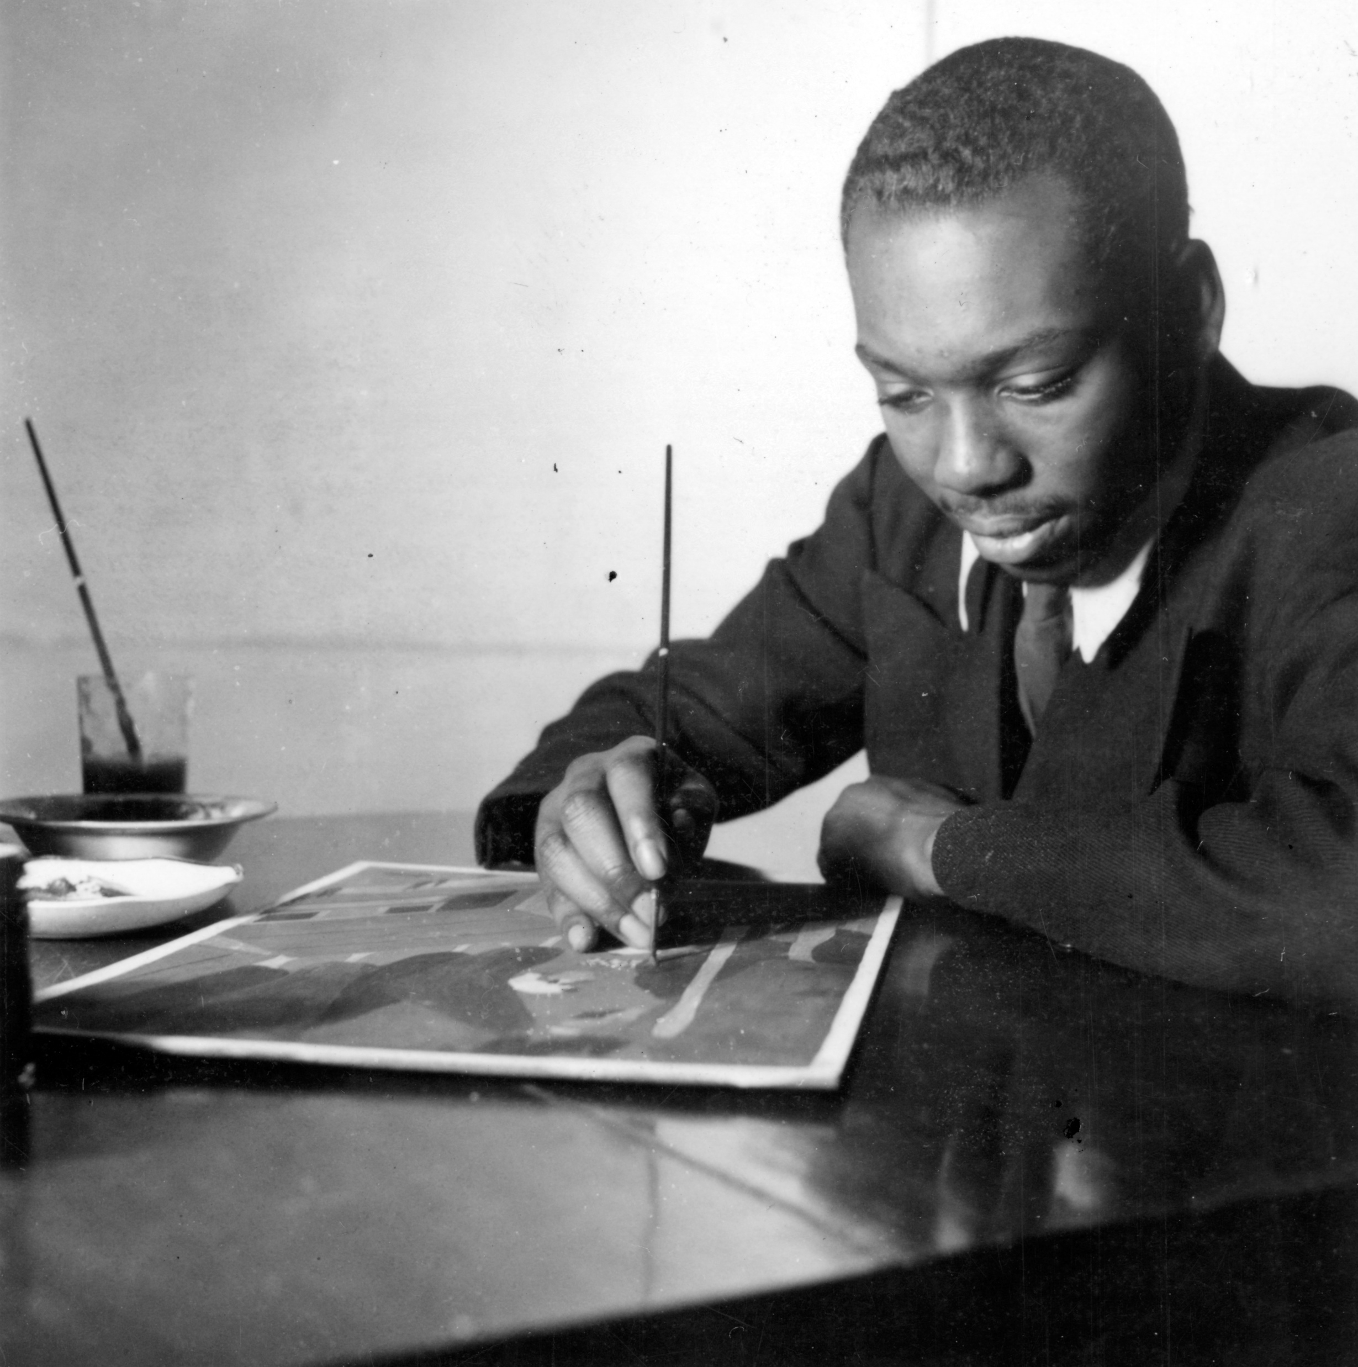
Chaim Gross’s friend and fellow artist, Jacob Lawrence (below), also found his passion for art by taking classes at a community center (also called a settlement house), called the Utopia Children’s House (left).
Jack Allison, Utopia Children's House from New York, New York, 1938, negative, 2 ¼ × 2 ¼ inches
Kenneth F. Space, Photograph of Jacob Lawrence, c. 1939.

Slide 13
It was located in Harlem, a neighborhood in Manhattan, and it helped Black Americans who had moved from the South to New York City seeking a better life, like Jacob Lawrence and his family.
Kenneth F. Space, Photograph of Jacob Lawrence, c. 1939.
Jack Allison, Utopia Children's House from New York, New York, 1938, negative, 2 ¼ × 2 ¼ inches

Slide 14
Like the Educational Alliance, the Utopia Children’s House offered meals, childcare, medical care, and classes that taught useful job skills. They also had music and art classes.
Kenneth F. Space, Photograph of Jacob Lawrence, c. 1939.
Jack Allison, Utopia Children's House from New York, New York, 1938, negative, 2 ¼ × 2 ¼ inches

Slide 15
What are some places in your community that help people learn and grow? Why are community centers like these important?
Jack Allison, Utopia Children's House from New York, New York, 1938, negative, 2 ¼ × 2 ¼ inches
Kenneth F. Space, Photograph of Jacob Lawrence, c. 1939.

Slide 16
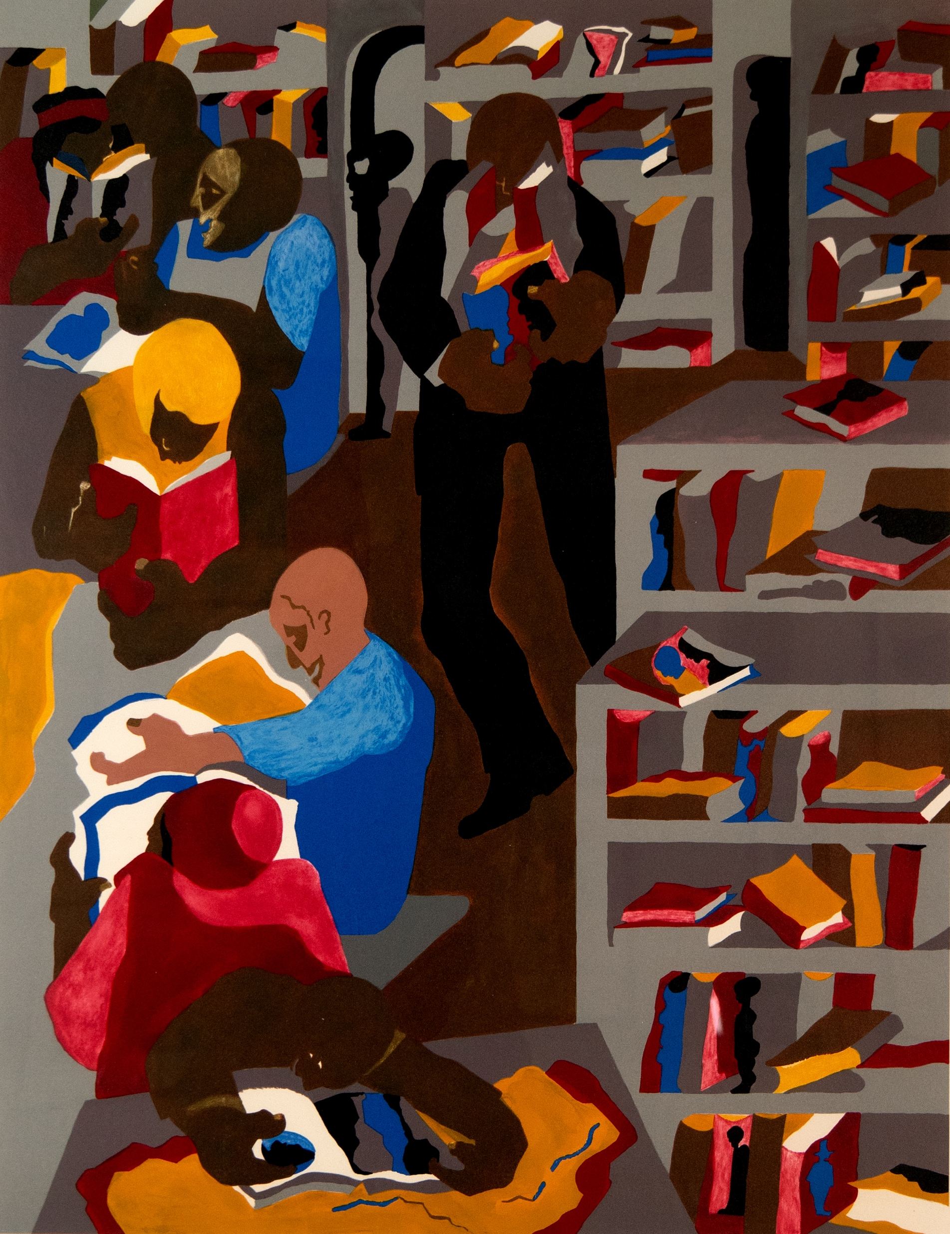
Jacob Lawrence found inspiration at the local library in Harlem. There, he could read about Black history and culture, which became the subject matter for his art. This print shows a scene inside the library. Look closely at it for a few moments. What are the people doing in this picture? What do you see that tells you it is a library?
Jacob Lawrence, Schomburg Library, 1986, silkscreen, 33 ¼ × 23 ¾ inches

Slide 17
What do you think Jacob Lawrence appreciated about libraries? What do you see that tells you that? What do you enjoy about going to the library?
Jacob Lawrence, Schomburg Library, 1986, silkscreen, 33 ¼ × 23 ¾ inches

Slide 18
Image Credits
Facade of the Educational Alliance, c. 1900, photograph. From the Archives of the YIVO Institute for Jewish Research, New York.
Photograph of students at the Educational Alliance Art School, including Peter Blume, Chaim Gross (back row), Elias Grossman (front row), Leo Jackinson, and Abbo Ostrowsky, 1922, 3 ⅜ × 5 ¼ inches. Archives of the Renee & Chaim Gross Foundation, New York.
Children's cooking class at Educational Alliance, c. 1910, photograph. From the Archives of the YIVO Institute for Jewish Research, New York.
A class in dressmaking, c. 1920s, photograph. From the Archives of the YIVO Institute for Jewish Research, New York.
Marion Palfi, Chaim Gross teaching at the Educational Alliance, 1944, photograph, 7 × 9 ⅛ inches. Archives of the Renee & Chaim Gross Foundation, New York. © Center for Creative Photography, Arizona Board of Regents.
Jack Allison, Utopia Children's House from New York, New York, 1938, negative, 2 ¼ × 2 ¼ inches. Prints and Photographs Division, Library of Congress, Washington, D.C.
Kenneth F. Space, Photograph of Jacob Lawrence, c. 1939. Harmon Foundation Collection, National Archives and Records Administration, College Park, MD.
Jacob Lawrence, Schomburg Library, 1986, silkscreen, 33 ¼ × 23 ¾ inches. Renee & Chaim Gross Foundation, New York. © 2024 The Jacob and Gwendolyn Knight Lawrence Foundation, Seattle / Artists Rights Society (ARS), New York.

Slide 19
First established in 1974 with donations from over two dozen close friends and supporters of American artist Chaim Gross (1902-91), the Renee & Chaim Gross Foundation was incorporated as a 501(c)(3) not-for-profit organization in 1989. The Foundation is located in the couple's historic Greenwich Village townhouse and the artist’s studio space at 526 LaGuardia Place.
The Foundation stewards an extensive collection of over 12,000 objects that includes Gross’s sculptures, drawings, and prints; a photographic archive; and their large personal collection of African, Oceanic, Pre-Columbian, American, and European art that remains installed in the townhouse as it was during their lifetimes.
Our mission is to further the legacy of Chaim Gross through high-quality research, exhibitions, and educational activities around our historic building and art collections for audiences in New York City and beyond.
rcgrossfoundation.org
This project is generously supported by a grant from the Dorothy C. Radgowski Learning Through Women’s Achievement in the Arts Grant, a joint effort of Where Women Made History (WWMH), and Historic Artists’ Homes & Studios (HAHS), both programs of the National Trust for Historic Preservation.

